Slide 1
LOWER SIXTH ARTS
GEOGRAPHY
Lesson 1
Relief of Cameroon
Notes:
Good morning, class, and welcome to our geography lesson. I am your geography teacher, Mr Kamdem. Today we are starting Lesson 1: Relief of Cameroon.

Slide 2
CLASS INFO
Class, Chapter and Duration
Class | Lower Sixth Arts
Chapter | Geography of Cameroon
Duration | 2 periods (2 × 50 minutes)
Notes:
This lesson is for Lower Sixth Arts. It belongs to Geography of Cameroon. We shall need 2 periods to cover it.

Slide 3
IDENTIFICATION
Lesson Identification
Topic | Geography of Cameroon
Sub-topic | The Physical Environment of Cameroon
Lesson | Lesson 1: Relief of Cameroon
Notions / Concepts | Relief, physiography, physiographic region, highland, lowland, plateau, depression, Cameroon Volcanic Line.
Syllabus focus | Physiography: physiographic regions; major highlands and lowlands of Cameroon; general characteristics of each unit.
Competence | Learners are able to identify the physiographic regions of Cameroon on a map and describe the characteristics of its major highlands and lowlands.
Notes:
Our topic is Geography of Cameroon, and the sub-topic is The Physical Environment of Cameroon. The key notions we shall use today are: relief, physiography, physiographic region, highland, lowland, plateau, depression, Cameroon Volcanic Line. At the end, you should be able to do this: learners are able to identify the physiographic regions of Cameroon on a map and describe the characteristics of its major highlands and lowlands.

Slide 4

LESSON PLAN
Lesson Plan
Objectives and recall
Real-life situation and action to take
Learning activities
Board summary
Evaluation, remediation and homework
Notes:
Here is the plan of our lesson today. First, we shall look at the objectives and recall what you already know. After that, we shall study a situation from real life and the action to take, and do the learning activities. Finally, we shall copy the board summary, do the evaluation and the remediation, and I will give you the homework.

Slide 5
OBJECTIVES
Objectives
By the end of this lesson, you should be able to:
Define relief, physiography, highland and lowland.
Identify the major physiographic regions of Cameroon on a map.
Notes:
Take your time to copy this part; we will continue together.

Slide 6
OBJECTIVES
Objectives (continued)
Describe the general characteristics of the major highlands.
Describe the general characteristics of the major lowlands.
Notes:
By the end of this lesson, you should be able to do four things. Number 1: define relief, physiography, highland and lowland. Number 2: identify the major physiographic regions of Cameroon on a map. Number 3: describe the general characteristics of the major highlands. Number 4: describe the general characteristics of the major lowlands.

Slide 7
PREVIOUS KNOWLEDGE
Previous Knowledge
Relief is made of mountains, plateaux, plains and valleys.
Altitude is the height of a place above sea level.
Cameroon lies in Central Africa, on the Gulf of Guinea.
Notes:
Let us first remember what you already know. Relief is made of mountains, plateaux, plains and valleys. Altitude is the height of a place above sea level. Cameroon lies in Central Africa, on the Gulf of Guinea. Keep this in mind, because we shall build on it today.

Slide 8
REAL-LIFE SITUATION
Situation in Real Life
Your family travels from Garoua to Mokolo for a festival.
Around Garoua the land is flat for many kilometres, with wide fields of cotton and millet; near Mokolo the bus climbs steep, winding roads between rocky mountains, and the air becomes cooler.
Notes:
Take your time to copy this part; we will continue together.

Slide 9
REAL-LIFE SITUATION
Situation in Real Life (continued)
"
Notes:
Listen carefully to this situation from real life. Your family travels from Garoua to Mokolo for a festival. Around Garoua the land is flat for many kilometres, with wide fields of cotton and millet; near Mokolo the bus climbs steep, winding roads between rocky mountains, and the air becomes cooler. Your little brother asks: "Why is the land so flat around Garoua and so mountainous near Mokolo, and what does the rest of Cameroon look like?" Think about it, because I am going to ask you some questions.

Slide 10
REAL-LIFE SITUATION
Situation: Question 1
What is the problem in the situation?
Notes:
Question 1: What is the problem in the situation? Think for a moment, then raise your hand to answer.

Slide 11
REAL-LIFE SITUATION
Answer
The brother does not know why the relief changes between Garoua and Mokolo, nor what the relief of Cameroon is like.
Notes:
Good. The brother does not know why the relief changes between Garoua and Mokolo, nor what the relief of Cameroon is like.

Slide 12
REAL-LIFE SITUATION
Situation: Question 2
In which relief unit is Garoua?
Notes:
Question 2: In which relief unit is Garoua? Think for a moment, then raise your hand to answer.

Slide 13
REAL-LIFE SITUATION
Answer
In the Benue depression, part of the Northern lowlands.
Notes:
Good. In the Benue depression, part of the Northern lowlands.

Slide 14
REAL-LIFE SITUATION
Situation: Question 3
Which mountains are near Mokolo?
Notes:
Question 3: Which mountains are near Mokolo? Think for a moment, then raise your hand to answer.

Slide 15
REAL-LIFE SITUATION
Possible Answer
The Mandara Mountains.
Notes:
Good. The Mandara Mountains.

Slide 16
ACTION TO TAKE
Action to Take
Use a relief map of Cameroon to explain differences in farming, roads and settlement between regions.
Notes:
From this situation, the action we are working towards in this lesson is the following: use a relief map of Cameroon to explain differences in farming, roads and settlement between regions.

Slide 17
JUSTIFICATION
Justification of the Lesson
This lesson helps us to understand the relief of Cameroon, which influences its climate, rivers, soils, population and economic activities.
Notes:
Why is this lesson important for you? This lesson helps us to understand the relief of Cameroon, which influences its climate, rivers, soils, population and economic activities.

Slide 18

1. PHYSIOGRAPHIC REGIONS
Activity 1
The relief of Cameroon.
Notes:
Activity 1. Look carefully at this diagram: the relief of Cameroon. Observe every detail before I ask the question.

Slide 19
1. PHYSIOGRAPHIC REGIONS
Activity 1: Question
Which relief unit lies in the centre of Cameroon, between the south and the north?
Notes:
Here is the question for Activity 1: Which relief unit lies in the centre of Cameroon, between the south and the north? Take one minute to think and write your answer in your rough notebook.

Slide 20
1. PHYSIOGRAPHIC REGIONS
Activity 1: Answer
The Adamawa Plateau.
Notes:
Let us check the answer together. The Adamawa Plateau.

Slide 21

2. MAJOR HIGHLANDS
Activity 2
Mount Cameroon.
Notes:
Activity 2. Look carefully at this picture: mount Cameroon. Observe every detail before I ask the question.

Slide 22
2. MAJOR HIGHLANDS
Activity 2: Question
What is the highest mountain of Cameroon?
Notes:
Here is the question for Activity 2: What is the highest mountain of Cameroon? Take one minute to think and write your answer in your rough notebook.

Slide 23
2. MAJOR HIGHLANDS
Activity 2: Answer
Mount Cameroon (4,095 m), an active volcano near Buea.
Notes:
Let us check the answer together. Mount Cameroon (4,095 m), an active volcano near Buea.

Slide 24
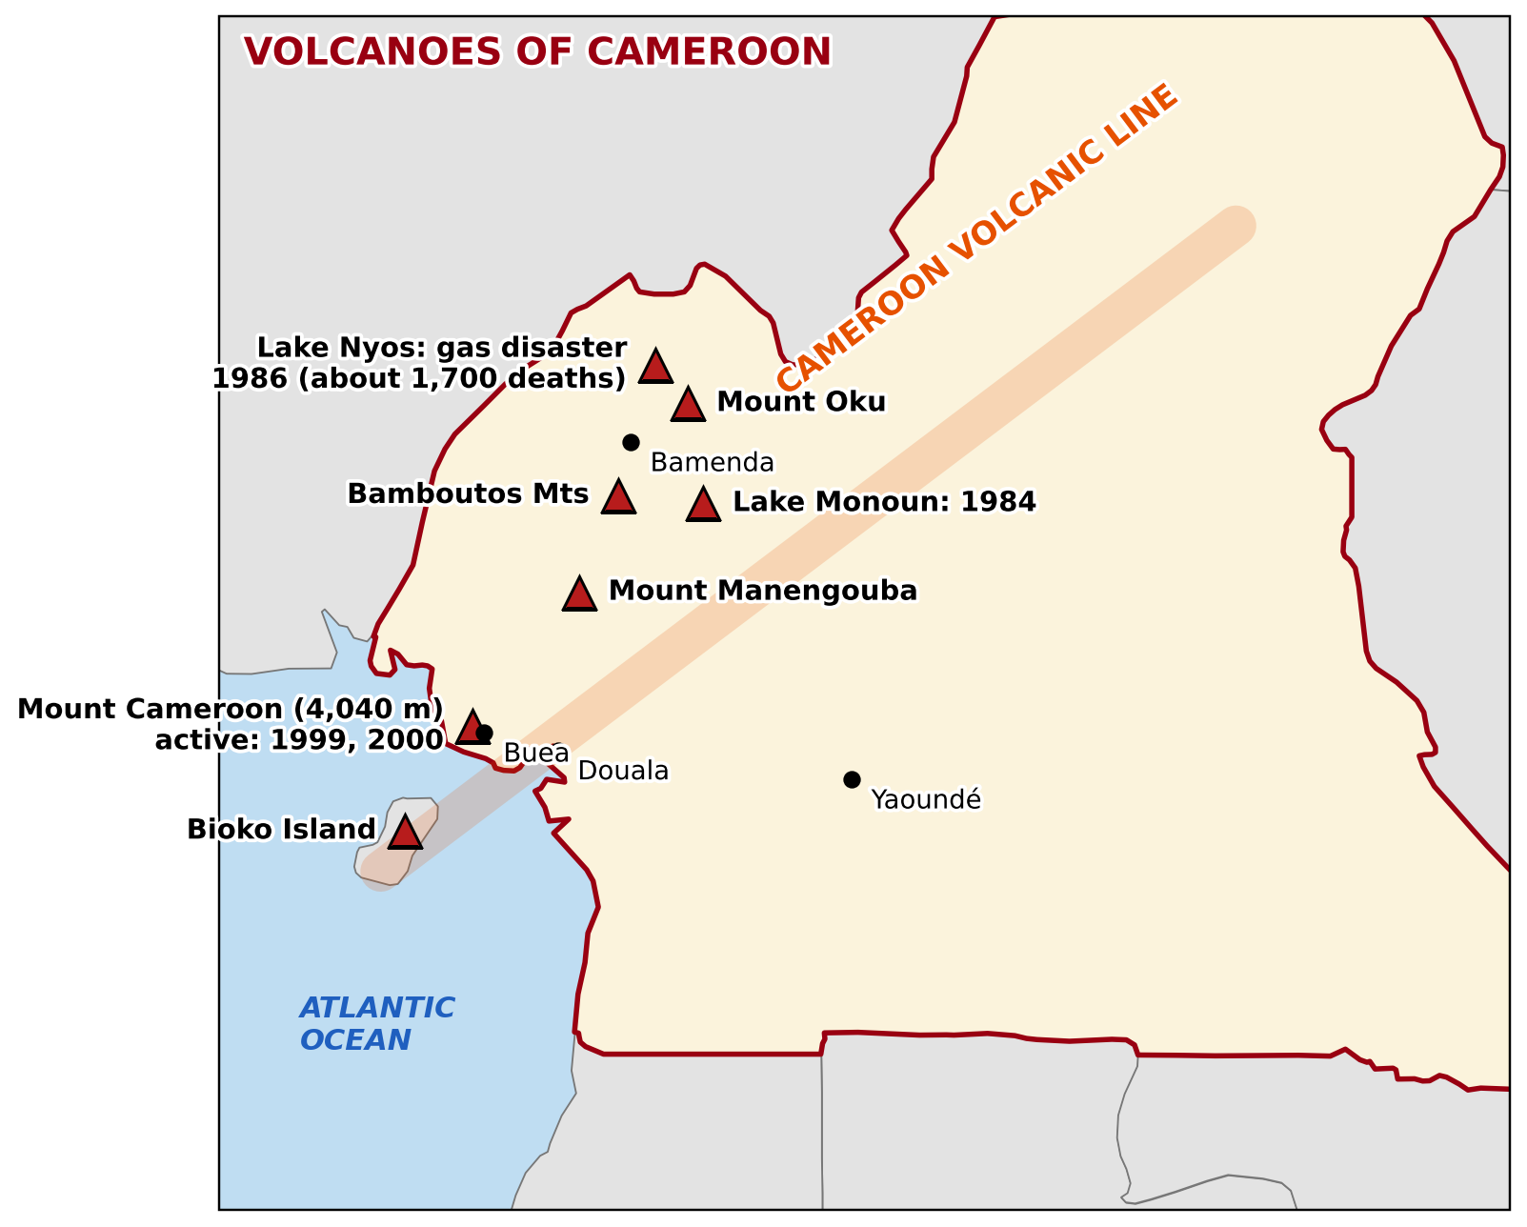
2. MAJOR HIGHLANDS
Activity 3
Volcanoes of Cameroon.
Notes:
Activity 3. Look carefully at this picture: volcanoes of Cameroon. Observe every detail before I ask the question.

Slide 25
2. MAJOR HIGHLANDS
Activity 3: Question
In which direction are the volcanic mountains of the West arranged?
Notes:
Here is the question for Activity 3: In which direction are the volcanic mountains of the West arranged? Take one minute to think and write your answer in your rough notebook.

Slide 26
2. MAJOR HIGHLANDS
Activity 3: Answer
In a line from the south-west to the north-east: the Cameroon Volcanic Line.
Notes:
Let us check the answer together. In a line from the south-west to the north-east: the Cameroon Volcanic Line.

Slide 27
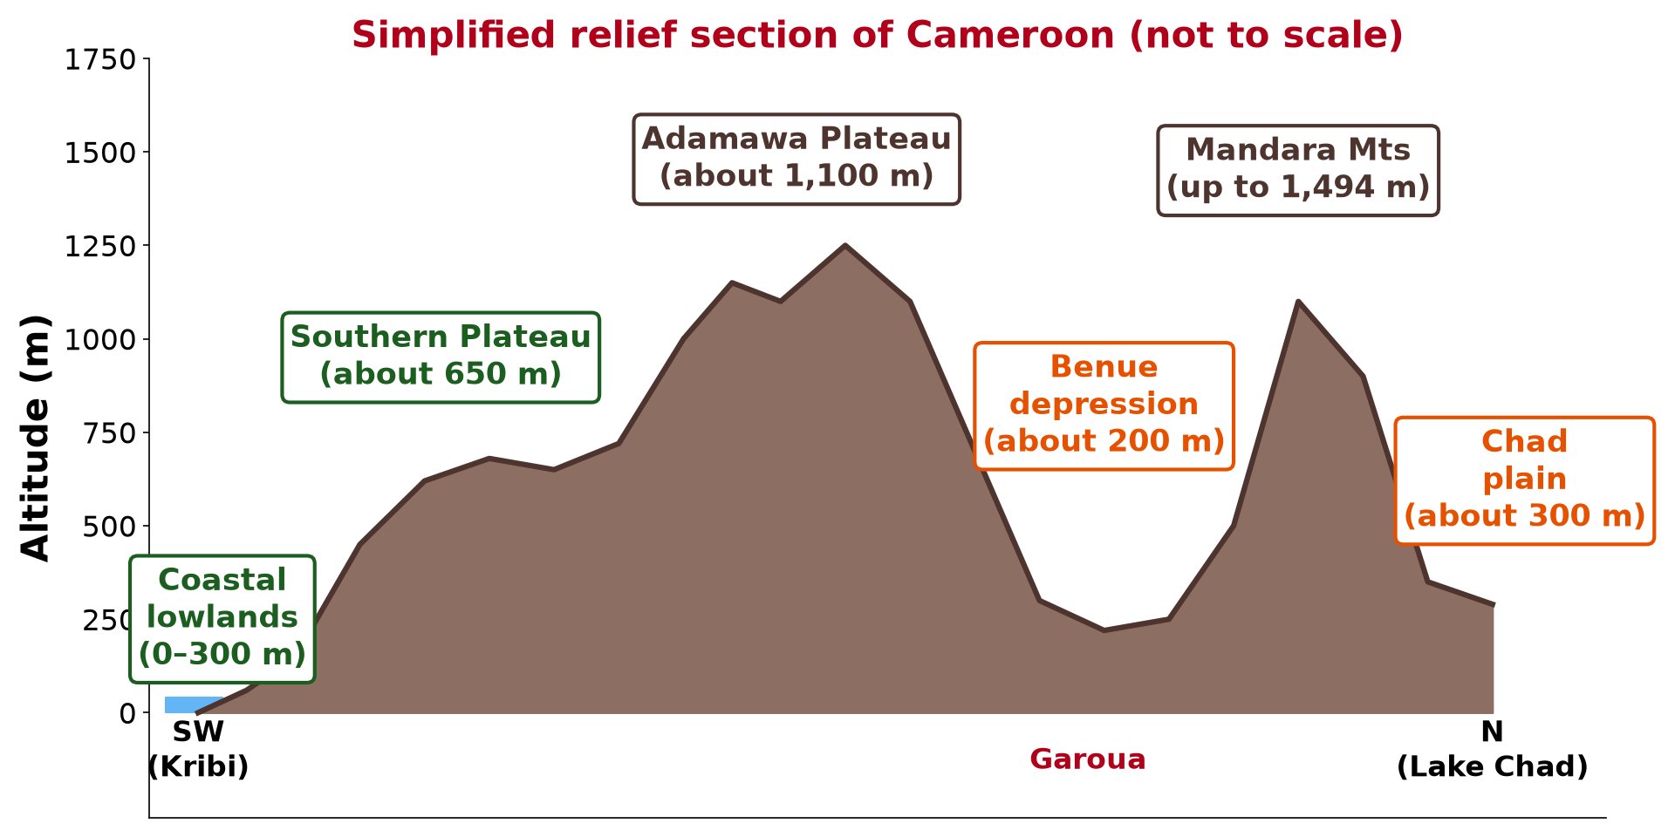
3. MAJOR LOWLANDS
Activity 4
A relief section of Cameroon.
Notes:
Activity 4. Look carefully at this diagram: a relief section of Cameroon. Observe every detail before I ask the question.

Slide 28
3. MAJOR LOWLANDS
Activity 4: Question
Why is Garoua much lower than Ngaoundéré?
Notes:
Here is the question for Activity 4: Why is Garoua much lower than Ngaoundéré? Take one minute to think and write your answer in your rough notebook.

Slide 29
3. MAJOR LOWLANDS
Activity 4: Answer
Garoua is in the Benue depression (about 200 m), while Ngaoundéré is on the Adamawa Plateau (about 1,100 m).
Notes:
Let us check the answer together. Garoua is in the Benue depression (about 200 m), while Ngaoundéré is on the Adamawa Plateau (about 1,100 m).

Slide 30

3. MAJOR LOWLANDS
Activity 5
Mountains of the Far North.
Notes:
Activity 5. Look carefully at this picture: mountains of the Far North. Observe every detail before I ask the question.

Slide 31
3. MAJOR LOWLANDS
Activity 5: Question
Which mountains rise above the northern lowlands near Mokolo?
Notes:
Here is the question for Activity 5: Which mountains rise above the northern lowlands near Mokolo? Take one minute to think and write your answer in your rough notebook.

Slide 32
3. MAJOR LOWLANDS
Activity 5: Answer
The Mandara Mountains.
Notes:
Let us check the answer together. The Mandara Mountains.

Slide 33
BOARD SUMMARY
Board Summary
Topic: Geography of Cameroon
Sub-topic: The Physical Environment of Cameroon
Lesson 1: Relief of Cameroon
Notes:
Now we are going to copy the board summary. Write the title and the headings neatly in your notebooks. I will give you enough time for each slide, so do not rush.

Slide 34
BOARD SUMMARY
DEFINITIONS
The key terms of this lesson are defined as follows:
Relief: It is the shape of the Earth's surface: its altitude and its slopes (mountains, plateaux, plains, valleys).
Notes:
Let us copy the definitions. The key terms of this lesson are defined as follows. On this slide we have Relief. Write each point on a new line, with the key term first, and explain it in your own words when we revise. When you finish, we go to the next slide.

Slide 35
BOARD SUMMARY
DEFINITIONS (continued)
Physiography: It is the description of the landforms of an area and of the processes that formed them.
Physiographic region: It is a large area with the same general type of relief.
Notes:
We continue with the definitions. On this slide we have Physiography and Physiographic region. Write each point on a new line, with the key term first, and explain it in your own words when we revise. When you finish, we go to the next slide.

Slide 36
BOARD SUMMARY
DEFINITIONS (continued)
Highland: It is land that stands high above the surrounding area, such as a mountain range or a high plateau.
Lowland: It is low, generally flat land, such as a plain, a basin or a depression.
Notes:
We continue with the definitions. On this slide we have Highland and Lowland. Write each point on a new line, with the key term first, and explain it in your own words when we revise.

Slide 37
BOARD SUMMARY
1. Physiography: The Physiographic Regions
The general features and the physiographic regions of Cameroon are the following:
Varied relief: Cameroon has high volcanic mountains, plateaux, basins and plains, which is one reason why it is called "Africa in miniature".
Illustration: the relief of Cameroon
Notes:
Let us copy Physiography: The Physiographic Regions. The general features and the physiographic regions of Cameroon are the following. Copy the point on Varied relief on the left, then draw the diagram on the right: the relief of Cameroon. Give it a title and label it clearly.

Slide 38
BOARD SUMMARY
1. Physiography: The Physiographic Regions
Major highlands:
The Western Highlands.
The Adamawa Plateau.
The Southern (South Cameroon) Plateau.
Major lowlands:
The Coastal lowlands.
Notes:
We continue with Physiography: The Physiographic Regions. On this slide we have Major highlands and Major lowlands. Write each point on a new line, with the key term first, and explain it in your own words when we revise. When you finish, we go to the next slide.

Slide 39
BOARD SUMMARY
1. Physiography: The Physiographic Regions (continued)
The Northern lowlands (Benue depression and Chad plain), dominated by the Mandara Mountains.
Notes:
We continue with Physiography: The Physiographic Regions. Copy this carefully.

Slide 40
BOARD SUMMARY
1. Physiography: The Physiographic Regions
General arrangement: The land rises from the coast to the central highlands, then falls to the Benue depression and the Chad plain.
Illustration: a relief section of Cameroon
Notes:
Copy the point on General arrangement on the left, then draw the diagram on the right: a relief section of Cameroon. Give it a title and label it clearly.

Slide 41

BOARD SUMMARY
2. The Major Highlands
A) The Western Highlands
The location and characteristics of the Western Highlands are the following:
Location: They cover the West, the North-West and parts of the South-West and Littoral Regions.
Illustration: the Bamenda Highlands
Notes:
Let us copy The Western Highlands. The location and characteristics of the Western Highlands are the following. Copy the point on Location on the left, then draw the diagram on the right: the Bamenda Highlands. Give it a title and label it clearly.

Slide 42
BOARD SUMMARY
2. The Major Highlands
A) The Western Highlands
Volcanic origin: They lie on the Cameroon Volcanic Line, a chain of volcanoes running from the Gulf of Guinea to the north-east.
Illustration: the Cameroon Volcanic Line
Notes:
Copy the point on Volcanic origin on the left, then draw the diagram on the right: the Cameroon Volcanic Line. Give it a title and label it clearly.

Slide 43
BOARD SUMMARY
2. The Major Highlands
A) The Western Highlands
Altitude: Most of the land is above 1,000 m, with plateaux such as the Bamileke Plateau and the Bamenda Plateau.
Notes:
We continue with The Western Highlands. On this slide we have Altitude. Write each point on a new line, with the key term first, and explain it in your own words when we revise. When you finish, we go to the next slide.

Slide 44
BOARD SUMMARY
2. The Major Highlands
A) The Western Highlands (continued)
Main peaks:
Mount Cameroon (4,095 m), an active volcano and the highest peak of West and Central Africa.
Mount Oku (3,011 m).
The Bamboutos Mountains (2,740 m).
Notes:
We continue with The Western Highlands. On this slide we have Main peaks. Write each point on a new line, with the key term first, and explain it in your own words when we revise. When you finish, we go to the next slide.

Slide 45
BOARD SUMMARY
2. The Major Highlands
A) The Western Highlands (continued)
Mount Manengouba (2,411 m) and Mount Kupe (2,064 m).
Plains and valleys: The highlands contain lower areas such as the Ndop plain, the Mbaw-Tikar plain, the Mbo plain and the Menchum valley.
Notes:
We continue with The Western Highlands. On this slide we have Plains and valleys. Write each point on a new line, with the key term first, and explain it in your own words when we revise.

Slide 46
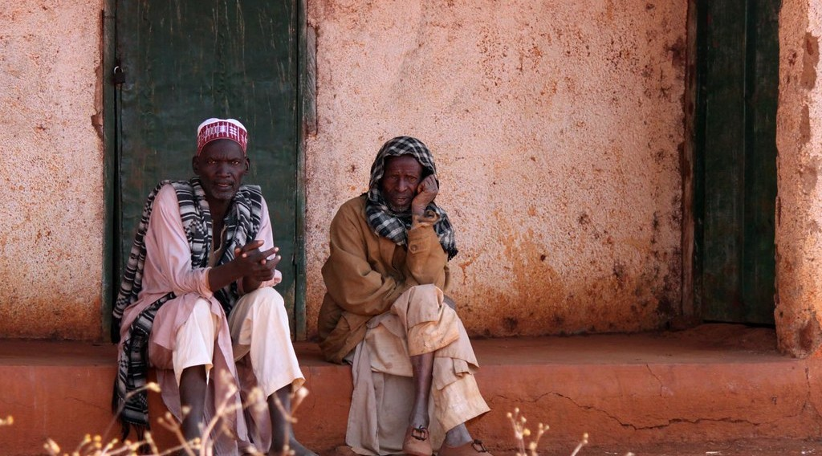
BOARD SUMMARY
2. The Major Highlands
B) The Adamawa Plateau
The location and characteristics of the Adamawa Plateau are the following:
Location: It crosses the centre of Cameroon from Nigeria to the Central African Republic.
Illustration: the Adamawa Plateau
Notes:
Let us copy The Adamawa Plateau. The location and characteristics of the Adamawa Plateau are the following. Copy the point on Location on the left, then draw the diagram on the right: the Adamawa Plateau. Give it a title and label it clearly.

Slide 47
BOARD SUMMARY
2. The Major Highlands
B) The Adamawa Plateau
Altitude and origin: It averages about 1,100 m and is an old block of hard rocks raised by faulting and covered in places by volcanic rocks.
Peaks: Volcanic peaks rise above it, such as Tchabal Mbabo (2,460 m).
Notes:
We continue with The Adamawa Plateau. On this slide we have Altitude and origin and Peaks. Write each point on a new line, with the key term first, and explain it in your own words when we revise. When you finish, we go to the next slide.

Slide 48
BOARD SUMMARY
2. The Major Highlands
B) The Adamawa Plateau (continued)
Escarpment: Its northern edge is a steep escarpment above the Benue depression, crossed by the road from Ngaoundéré to Garoua.
Notes:
We continue with The Adamawa Plateau. On this slide we have Escarpment. Write each point on a new line, with the key term first, and explain it in your own words when we revise. When you finish, we go to the next slide.

Slide 49
BOARD SUMMARY
2. The Major Highlands
B) The Adamawa Plateau (continued)
Main watershed: It is the main watershed of Cameroon: the Benue, the Vina (Logone), the Djerem (Sanaga) and other rivers rise on it.
Notes:
We continue with The Adamawa Plateau. On this slide we have Main watershed. Write each point on a new line, with the key term first, and explain it in your own words when we revise.

Slide 50
BOARD SUMMARY
2. The Major Highlands
C) The Southern Plateau
The location and characteristics of the Southern Plateau are the following:
Location: It covers the Centre, South and East Regions, south of the Adamawa and east of the coastal lowlands.
Altitude: It averages about 650 m.
Notes:
Let us copy The Southern Plateau. The location and characteristics of the Southern Plateau are the following. On this slide we have Location and Altitude. Write each point on a new line, with the key term first, and explain it in your own words when we revise. When you finish, we go to the next slide.

Slide 51
BOARD SUMMARY
2. The Major Highlands
C) The Southern Plateau (continued)
Rounded hills: It is dissected into many rounded, dome-shaped hills ("half-orange" relief), with inselbergs such as the hills around Yaoundé.
Highest points: Its highest hills include Mbam Minkom (about 1,295 m) near Yaoundé.
Notes:
We continue with The Southern Plateau. On this slide we have Rounded hills and Highest points. Write each point on a new line, with the key term first, and explain it in your own words when we revise. When you finish, we go to the next slide.

Slide 52
BOARD SUMMARY
2. The Major Highlands
C) The Southern Plateau (continued)
Drainage: It is drained by the Nyong, the Ntem and the tributaries of the Sanaga and the Congo.
Notes:
We continue with The Southern Plateau. On this slide we have Drainage. Write each point on a new line, with the key term first, and explain it in your own words when we revise.

Slide 53
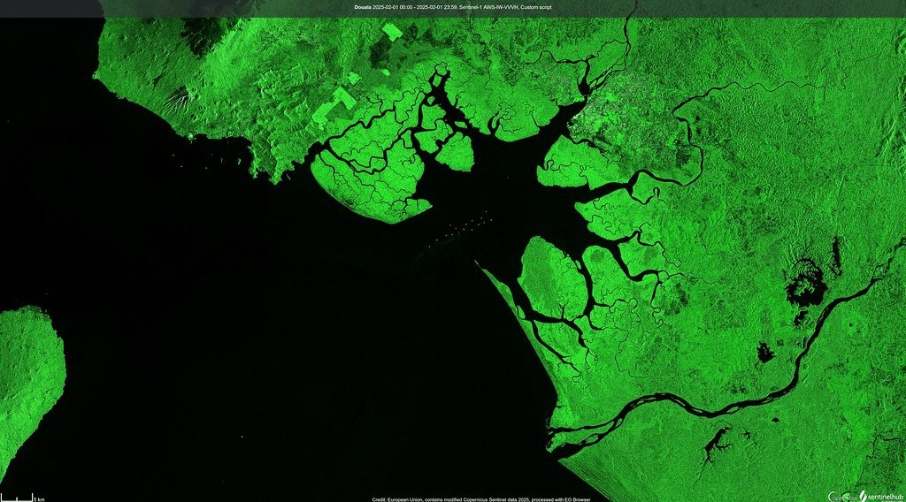
BOARD SUMMARY
3. The Major Lowlands
A) The Coastal Lowlands
The location and characteristics of the Coastal lowlands are the following:
Location and altitude: They stretch along the Atlantic coast from the Nigerian border to Equatorial Guinea, generally below 300 m.
Illustration: the Wouri estuary and Douala
Notes:
Let us copy The Coastal Lowlands. The location and characteristics of the Coastal lowlands are the following. Copy the point on Location and altitude on the left, then draw the diagram on the right: the Wouri estuary and Douala. Give it a title and label it clearly.

Slide 54
BOARD SUMMARY
3. The Major Lowlands
A) The Coastal Lowlands
Interruption: They are interrupted by the mass of Mount Cameroon, which reaches the sea near Limbe.
Sub-units:
The Mamfe and Ndian basins in the north-west.
Notes:
We continue with The Coastal Lowlands. On this slide we have Interruption and Sub-units. Write each point on a new line, with the key term first, and explain it in your own words when we revise. When you finish, we go to the next slide.

Slide 55
BOARD SUMMARY
3. The Major Lowlands
A) The Coastal Lowlands (continued)
The Douala basin, around the Wouri and Sanaga estuaries.
The rocky coast of Kribi and Campo in the south, with the Lobé Falls.
Features: They have estuaries, creeks, mangrove swamps and sandy beaches.
Notes:
We continue with The Coastal Lowlands. On this slide we have Features. Write each point on a new line, with the key term first, and explain it in your own words when we revise.

Slide 56
BOARD SUMMARY
3. The Major Lowlands
B) The Northern Lowlands
The location and characteristics of the Northern lowlands are the following:
Location: They cover most of the North and Far North Regions, north of the Adamawa Plateau.
Notes:
Let us copy The Northern Lowlands. The location and characteristics of the Northern lowlands are the following. On this slide we have Location. Write each point on a new line, with the key term first, and explain it in your own words when we revise.

Slide 57

BOARD SUMMARY
3. The Major Lowlands
B) The Northern Lowlands
The Benue depression: It is a long trough of sedimentary rocks drained by the Benue, about 200 m high at Garoua.
Illustration: the Benue at Garoua
Notes:
Copy the point on The Benue depression on the left, then draw the diagram on the right: the Benue at Garoua. Give it a title and label it clearly.

Slide 58
BOARD SUMMARY
3. The Major Lowlands
B) The Northern Lowlands
The Chad plain: It is a very flat plain of about 300 m that slopes gently towards Lake Chad, with the floodplains (yaérés) of the Logone.
Notes:
We continue with The Northern Lowlands. On this slide we have The Chad plain. Write each point on a new line, with the key term first, and explain it in your own words when we revise.

Slide 59
BOARD SUMMARY
3. The Major Lowlands
B) The Northern Lowlands
The Mandara Mountains: They rise above the plains along the Nigerian border, up to 1,494 m at Mount Oupay, with volcanic necks such as those of Rhumsiki.
Illustration: the Mandara Mountains
Notes:
Copy the point on The Mandara Mountains on the left, then draw the diagram on the right: the Mandara Mountains. Give it a title and label it clearly.

Slide 60
BOARD SUMMARY
3. The Major Lowlands
B) The Northern Lowlands
Other highlands: Isolated hills and inselbergs, such as the hills of Garoua and Pitoa, rise above the plains.
Notes:
We continue with The Northern Lowlands. On this slide we have Other highlands. Write each point on a new line, with the key term first, and explain it in your own words when we revise.

Slide 61
FORMATIVE EVALUATION
Evaluation 1
Name the three major highland units of Cameroon.
Notes:
Now let us check what you have understood. Question 1: Name the three major highland units of Cameroon. Answer in your exercise book.

Slide 62
FORMATIVE EVALUATION
Expected Answer
The Western Highlands, the Adamawa Plateau and the Southern Plateau.
Notes:
The expected answer is: the Western Highlands, the Adamawa Plateau and the Southern Plateau. If you got it right, well done.

Slide 63
FORMATIVE EVALUATION
Evaluation 2
Why is the Adamawa Plateau called the main watershed of Cameroon?
Notes:
Now let us check what you have understood. Question 2: Why is the Adamawa Plateau called the main watershed of Cameroon? Answer in your exercise book.

Slide 64
FORMATIVE EVALUATION
Expected Answer
Many major rivers rise on it and flow in different directions, such as the Benue, the Vina and the Djerem.
Notes:
The expected answer is: many major rivers rise on it and flow in different directions, such as the Benue, the Vina and the Djerem. If you got it right, well done.

Slide 65
REMEDIATION
Remediation
Fill in the blanks:
The highest peak of Cameroon is Mount ______ (4,095 m).
Garoua lies in the ______ depression.
The Western Highlands lie along the Cameroon ______ Line.
Notes:
For those who need more practice, fill in the blanks in your exercise book. The answers are: number 1, Cameroon; number 2, Benue; number 3, Volcanic.

Slide 66
HOMEWORK
Homework
Name the two air masses that affect the climate of Cameroon.
Notes:
For your homework: Name the two air masses that affect the climate of Cameroon. We shall correct it at the beginning of our next lesson.

Slide 67
NEXT LESSON
Next Lesson
Our next lesson will be on:
Lesson 2: The Climate of Cameroon
Notes:
Our next lesson will be on Lesson 2: The Climate of Cameroon. Thank you for your attention, and see you next time.

Slide 68
BILINGUAL GAME
Bilingual Game (Jeu Bilingue)
English | Français
Relief | Le relief
Highland | La haute terre
Lowland | La basse terre
Plateau | Le plateau
Mountain | La montagne
Depression | La dépression
Watershed | La ligne de partage des eaux
Plain | La plaine
Notes:
Let us play the bilingual game. I say a word in English, and you give me the French word. Then we do the reverse.

Slide 69
LOGBOOK
Official Logbook (1/2)
Module / Topic | Geography of Cameroon
Lesson Title | Lesson 1: Relief of Cameroon
Expected Learning Outcomes | Define relief, physiography, highland and lowland. Identify the major physiographic regions of Cameroon on a map. Describe the general characteristics of the major highlands. Describe the general characteristics of the major lowlands.
Competence | Learners are able to identify the physiographic regions of Cameroon on a map and describe the characteristics of its major highlands and lowlands.
Notes:
I record this information in the official logbook of the class after the lesson.

Slide 70
LOGBOOK
Official Logbook (2/2)
Matter Taught | DEFINITIONS; Physiography: The Physiographic Regions; The Western Highlands; The Adamawa Plateau; The Southern Plateau; The Coastal Lowlands; The Northern Lowlands.
Evaluation | Formative evaluation and remediation exercise.
Homework | Name the two air masses that affect the climate of Cameroon.
Enrolment / Present / Absent | ____ / ____ / ____
Achievement | To be completed after the lesson.
Notes:
I complete the second page of the logbook: the matter taught, the evaluation, the homework and the attendance.

Slide 71
TEACHER'S NOTE
Teacher's Note
Timing: Homework correction, plan, objectives 8 min | Recall, situation, action 10 min | 5 activities 30 min | Board summary (copying) 30 min | Evaluation, remediation 10 min | Homework, next lesson 5 min | Logbook 7 min
Without the projector (Activity 1): draw the outline of Cameroon and shade the highlands.
Without the projector (Activity 2): compare its height with the Adamawa Plateau.
Without the projector (Activity 3): draw the line on the sketch map.
Without the projector (Activity 4): draw the section on the board.
Without the projector (Activity 5): describe the road to Mokolo.
Notes:
This slide is for me, the teacher: it gives the timing of the lesson and what to do if the projector is not available.

Slide 72
REFERENCES
References
Geography Syllabus for Sixth Forms (Lower and Upper Sixth), MINESEC, 2019 — Geography of Cameroon.
Teacher's course notes: Mr KAMDEM E., Cameroon Geography (LSA), GBHS Garoua, 2026.
Photo, Activity 2: “Mount Cameroon” by John & Mel Kots, CC BY-NC-ND 2.0, via Flickr (https://www.flickr.com/photos/26745817@N00/2347261849)
Photo, Activity 5: “Rhumsiki peak, North Cameroon” by krishna.naudin, CC BY-SA 2.0, via Flickr (https://www.flickr.com/photos/141297921@N05/25989204581)
Photo, board summary (Location): “Bamenda, Cameroon” by jbdodane, CC BY-NC 2.0, via Flickr (https://www.flickr.com/photos/27998473@N02/11293877215)
Photo, board summary (Location): “At Dang and its livestock market” by 10b travelling / Carsten ten Brink, CC BY-NC-ND 2.0, via Flickr (https://www.flickr.com/photos/77334245@N00/7311224966)
Photo, board summary (Location and altitude): “Duala, Camerún (Douala, Cameroon)” by migmasat, Public domain 1.0, via Flickr (https://www.flickr.com/photos/197415759@N06/54386998088)
Notes:
Take your time to copy this part; we will continue together.

Slide 73
REFERENCES
References (continued)
Photo, board summary (The Benue depression): “Niamey, Niger” by LenDog64, CC BY-ND 2.0, via Flickr (https://www.flickr.com/photos/45968460@N03/4422209893)
Diagrams and animations: drawn for this lesson (Geography Department).
Notes:
These are the references and picture credits used to prepare this lesson.

